Slide 1
Great, wide, beautiful, wonderful world
By: William brightly Rands
Clara chandler

Slide 2
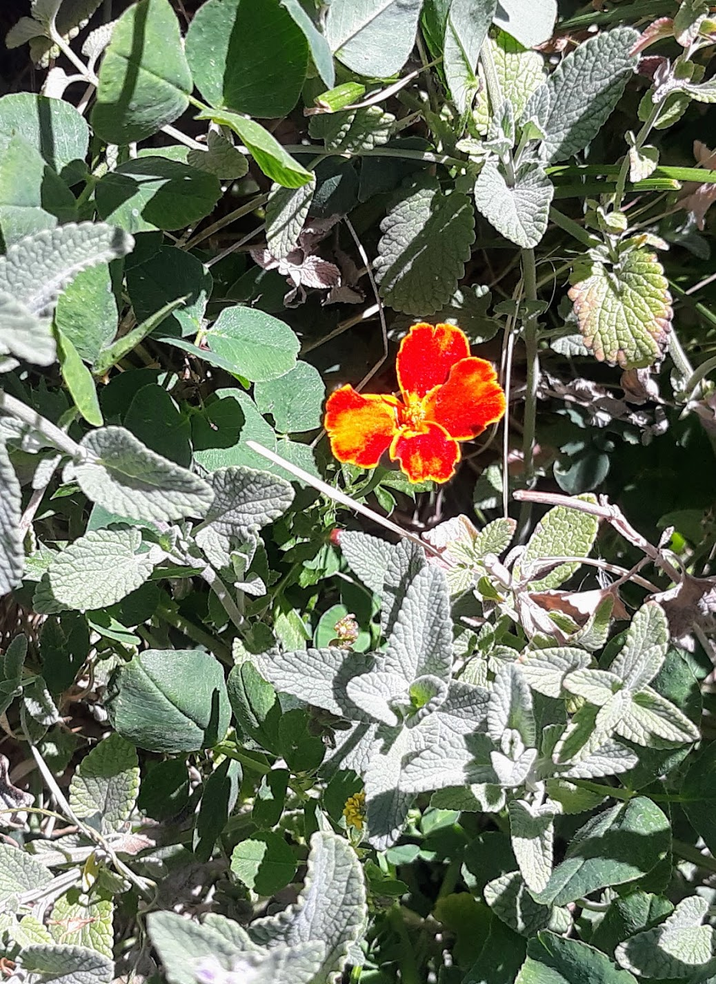
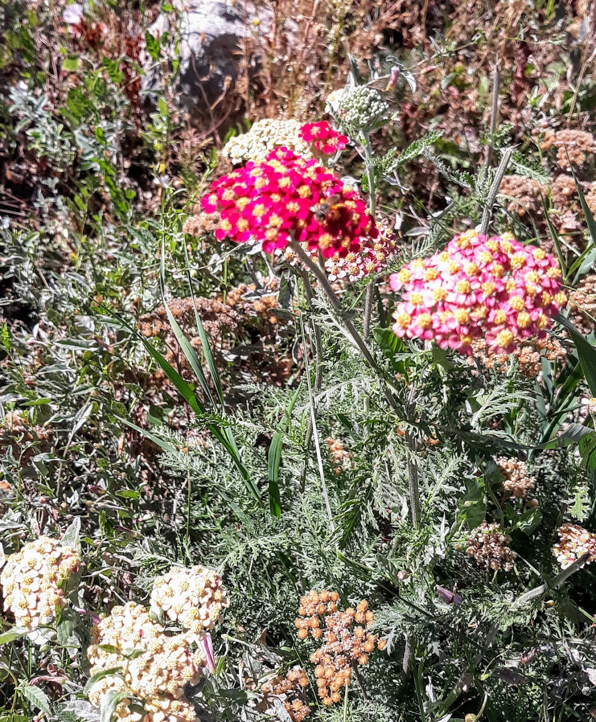
Great, wide, beautiful, wonderful World
With the wonderful water round you curled,
And the wonderful grass upon your breast
World, you are beautifully dressed

Slide 3
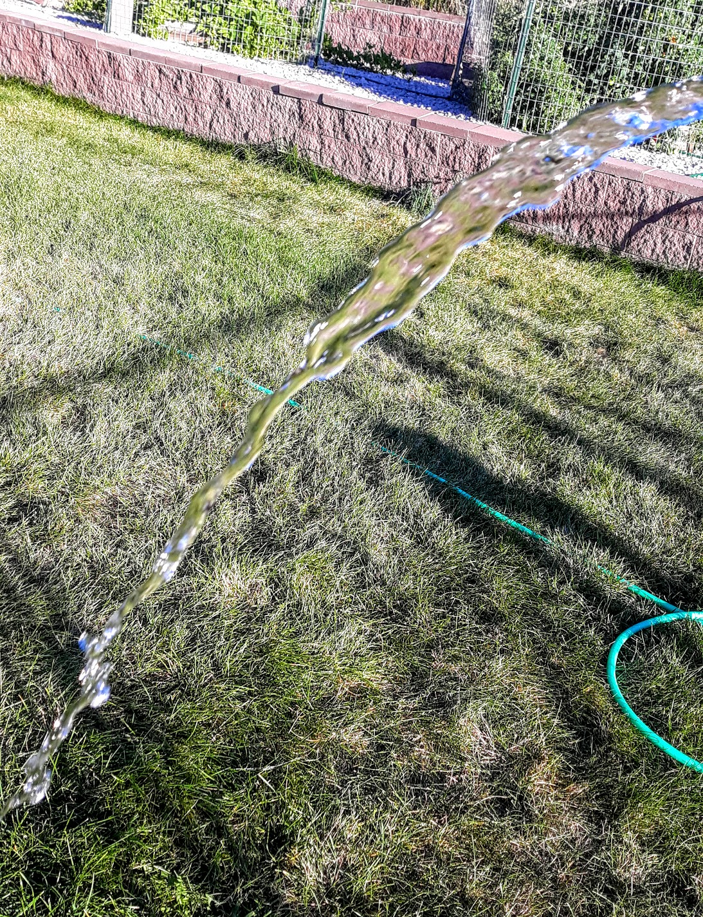
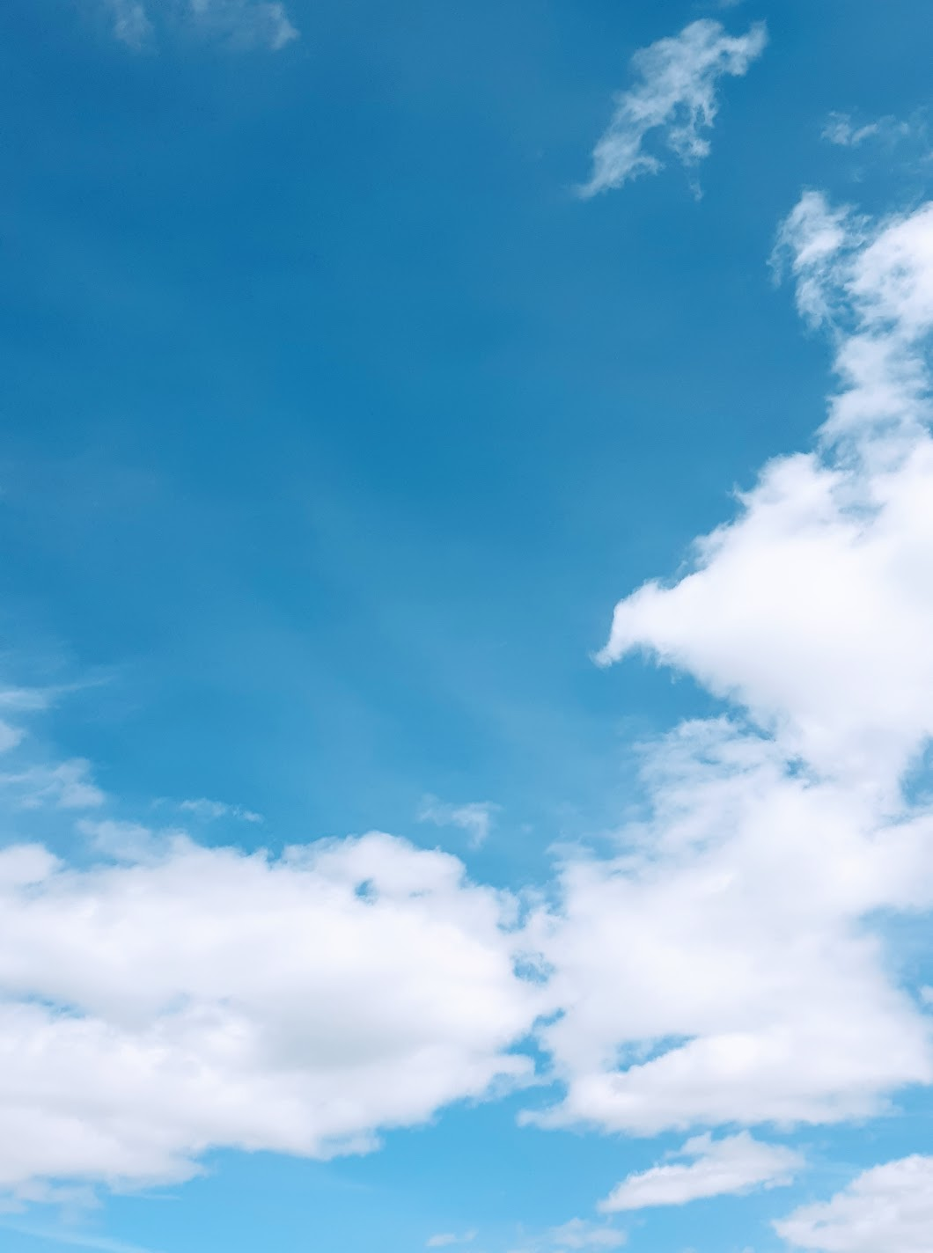
The wonderful air is over me,
And the wonderful wind is shaking the tree,
It walks on the water, and whirls the mills,
And talks to itself on the tops of the hills.

Slide 4
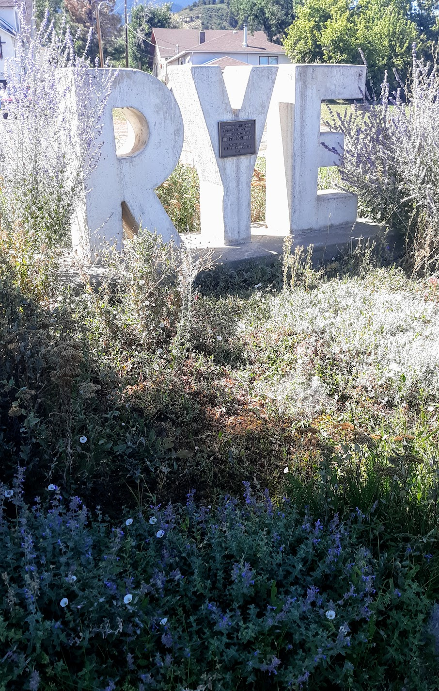
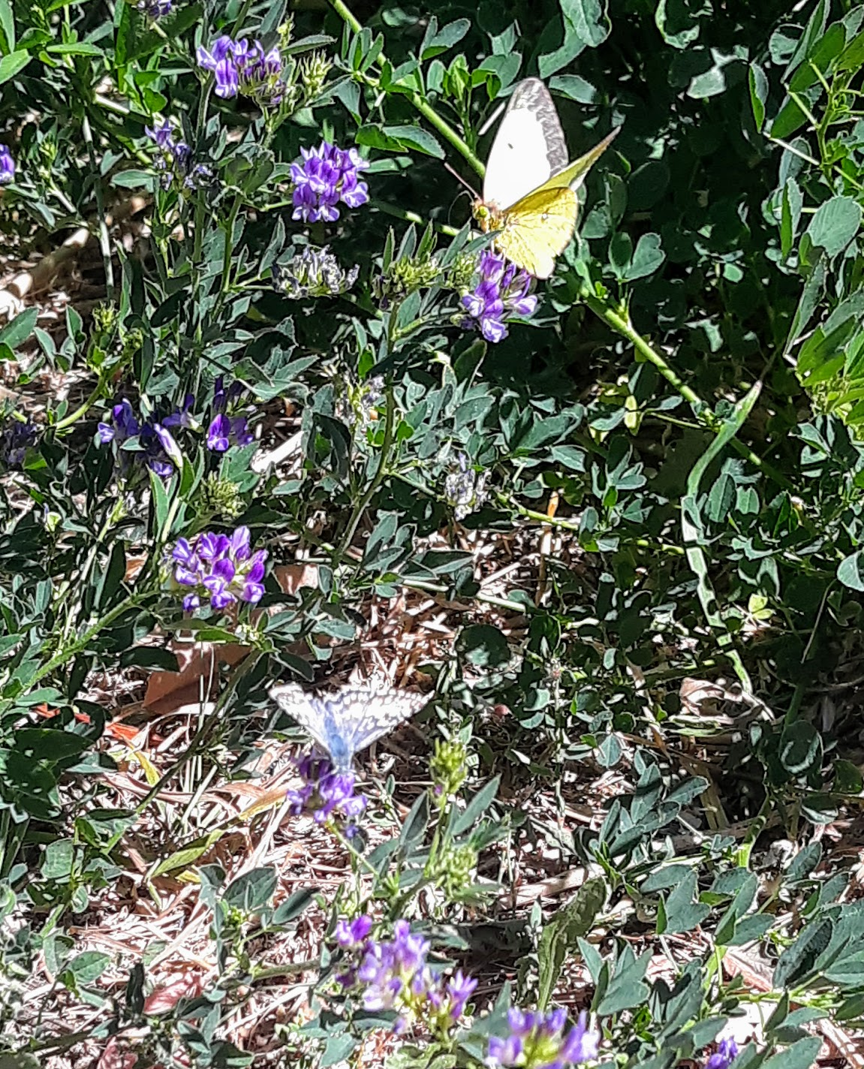
You friendly earth! how far do you go,
With the wheat-fields that nod and the rivers that flow,
With cities and gardens, and cliffs, and isles,
And people upon you for thousands of miles?

Slide 5
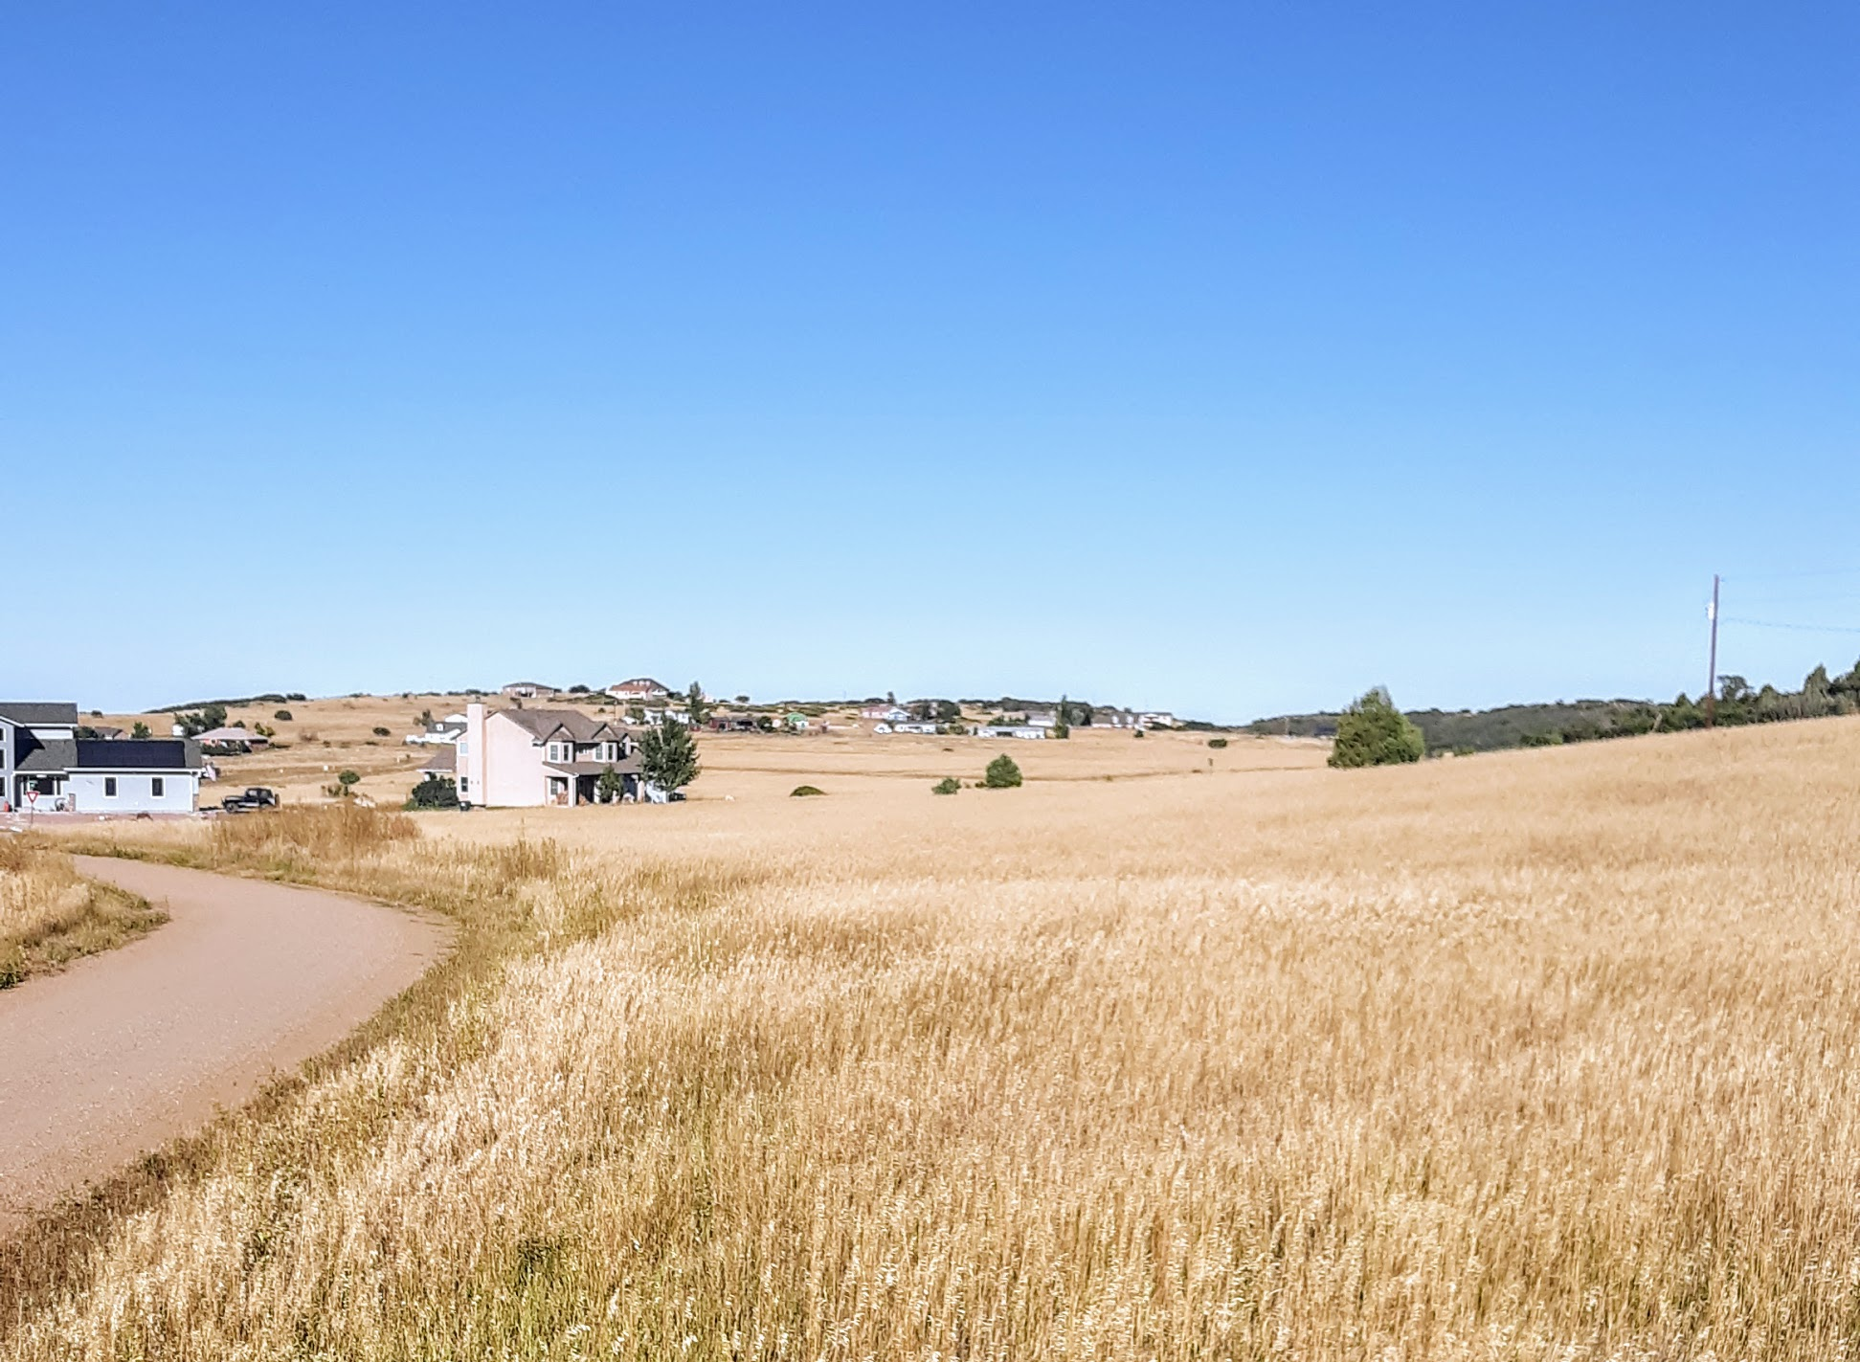
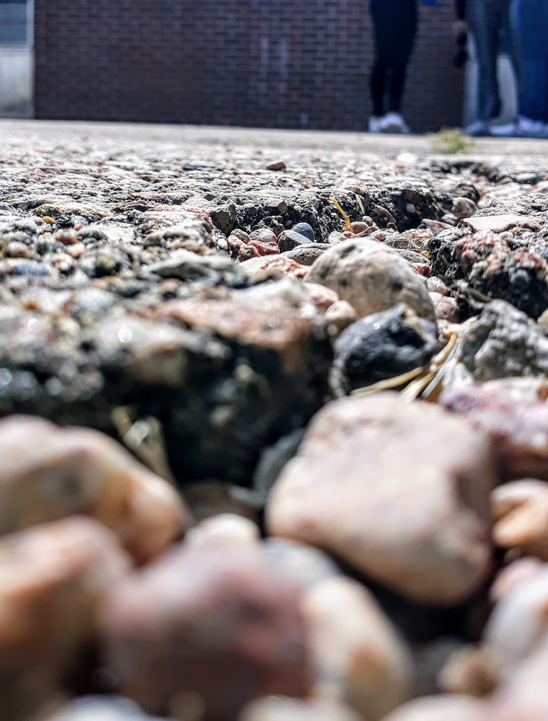
Ah, you are so great, and I am so small,
I tremble to think of you, World, at all;
And yet, when I said my prayers to-day,
“You are more than the earth, though you are such a dot:
You can love and think, and the earth cannot!”

